Slide 1
Popular Programming Tech
Part 2
Basics of GO Language / Tutorial

Slide 2
Learning Objective
LO 1 : Explain fundamental concept of GO Programming Language
LO 2 : Apply GO programming language techniques and libraries

Slide 3
Outline
Hello World
Command Line Arguments
Finding duplicate lines
Animated GIF’s
Fetching URL
Fetching URL Concurrently
A web server
Loose Ends

Slide 4
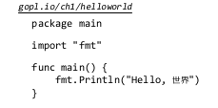
Hello World!
We’ll start with the now-traditional ‘‘hello, world’’ example, which appears at the beginning of The C Programming Language, published in 1978. C is one of the most direct influences on Go, and ‘‘hello, world’’ illustrates a number of central ideas.

Slide 5
Hello World (cont..)
Go is a compiled language. The Go toolchain converts a source program and the things it depends on into instructions in the native machine language of a computer.
These tools are accessed through a single command called go that has a number of subcommands. The simplest of these subcommands is run, which compiles the source code from one or more source files whose names end in .go, links it with libraries, then runs the resulting executable file
Go natively handles Unicode, so it can process text in all the world’s languages.

Slide 6

Running a program
If the program is more than a one-shot experiment, it’s likely that you would want to compile it once and save the compiled result for later use. That is done with go build:
This creates an executable binary file called helloworld that can be run any time without further processing:

Slide 7
GO to be watched
You must import exactly the packages you need. A program will not compile if there are missing imports or if there are unnecessary ones.
The import declarations must follow the package declaration. After that, a program consists of the declarations of functions, variables, constants, and types (introduced by the keywords func, var, const, and type)
A function declaration consists of the keyword func, the name of the function, a parameter list (empty for main), a result list (also empty here), and the body of the function—the statements that define what it does—enclosed in braces
Go does not require semicolons at the ends of statements or declarations, except where two or more appear on the same line

Slide 8

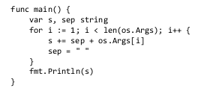
Command-Line Arguments
The os package provides functions and other values for dealing with the operating system in a platform-independent fashion.
The variable os.Args is a slice of strings

Slide 9
Comments
Comments begin with //. All text from a // to the end of the line is commentary for programmers and is ignored by the compiler

Slide 10

Declare Variable
There are several ways to declare a string variable; these are all equivalent:
The first form, a short variable declaration, is the most compact, but it may be used only within a function, not for package-level variables.
The second form relies on default initialization to the zero value for strings, which is "".
The third form is rarely used except when declaring multiple variables.
The fourth form is explicit about the variable’s type, which is redundant when it is the same as that of the initial value but necessary in other cases where they are not of the same type.

Slide 11
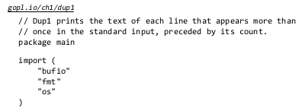
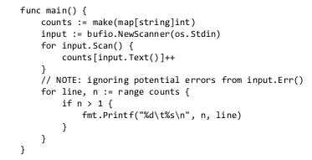
Finding Duplicate Lines
Programs for file copying, printing, searching, sorting, counting, and the like all have a similar structure

Slide 12
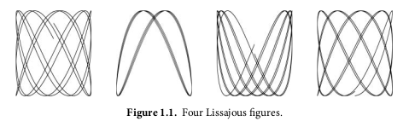
Animated GIF's
The next program demonstrates basic usage of Go’s standard image packages, which we’ll use to create a sequence of bit-mapped images and then encode the sequence as a GIF animation.
The images, called Lissajous figures, were a staple visual effect in sci-fi films of the 1960s. They are the parametric curves produced by harmonic oscillation in two dimensions, such as two sine waves fed into the x and y inputs of an oscilloscope

Slide 13
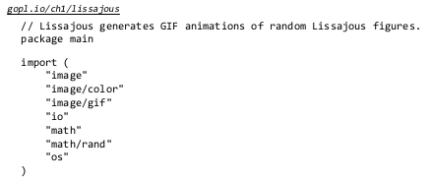
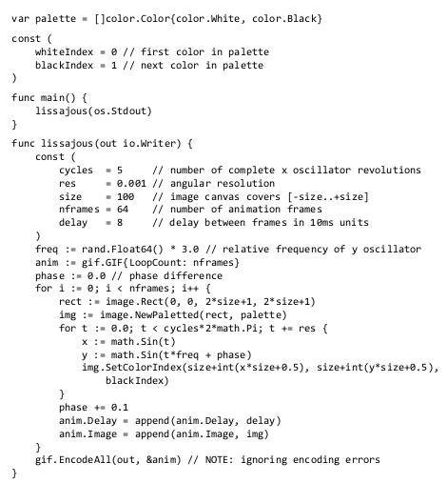

Slide 14
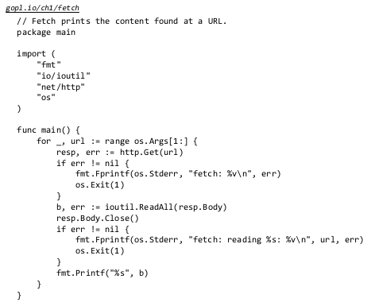
Fetching a URL
For many applications, access to information from the Internet is as important as access to the local file system.

Slide 15
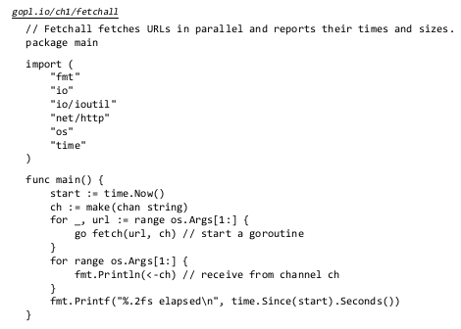
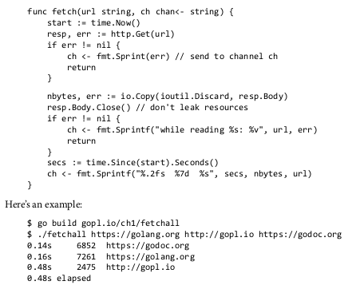
Fetching URLs Concurrently
One of the most interesting and novel aspects of Go is its support for concurrent programming
The next program, fetchall, does the same fetch of a URL’s contents as the previous example, but it fetches many URLs, all concurrently, so that the process will take no longer than the longest fetch rather than the sum of all the fetch time

Slide 16
Goroutines
A goroutine is a concurrent function execution.
A channel is a communication mechanism that allows one goroutine to pass values of a specified type to another goroutine
The function main runs in a goroutine and the go statement creates additional goroutines.

Slide 17
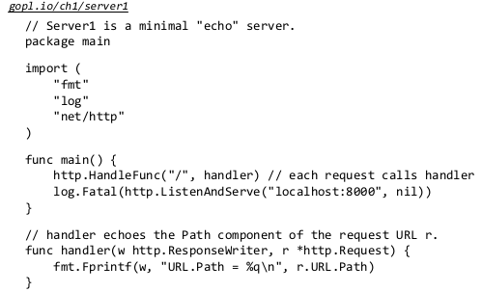
Web Server
Go’s libraries makes it easy to write a web server that responds to client requests like those made by fetch
In this section, we’ll show a minimal server that returns the path component of the URL used to access the server. That is, if the request is for http://localhost:8000/hello, the response will be URL.Path = "/hello".

Slide 18
Access
Let’s start the server in the background. On Mac OS X or Linux, add an ampersand (&) to the command; on Microsoft Windows, you will need to run the command without the ampersand in a separate command window.

Slide 19
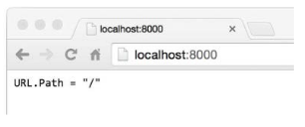

Access (2)
We can then make client requests from the command line:

Slide 20
References
https://go.dev/doc/install
https://gobyexample.com/hello-world

